Slide 1

DON’T PUT YOUR LIFE’S GREATEST HITS ON MUTE
Spring

Slide 2
DON’T PUT LIFE’S GREATEST HITS ON MUTE
CAMPAIGN TITLE
CAMPAIGN TITLE
Campaign Summary:
Music-themed campaign
Campaign’s focus is hearing, not device-centric
Marketing Channels: Internal, Digital, External
Existing ENT patients and prospecting audience

Slide 3


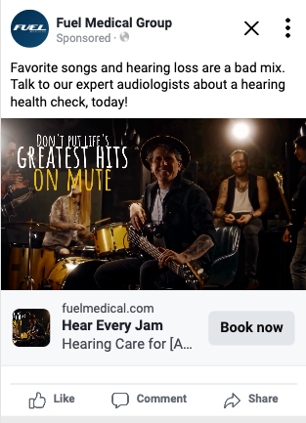

FM126550
CAMPAIGN SHOWCASE
CAMPAIGN TITLE
FM126871
Depending on budget spend, video ads may not be available for all social campaigns.
Preview link: http://fb.me/28FJ52pkxyZFFsD

Slide 4
STEP 1: Identify Your Goal
Consider your practice’s overall goal for the campaign. This will help to determine the campaign’s audience, channels and marketing focus.
New Patients
Patients Visit More Often
Patients Access More Services
CAMPAIGN STEPS:
Identify Your Goal
Select Your Channels
Plan Your Timeline
Referrals
Physician Referrals (office visits, letters, announcements, newsletters)
Patient Referrals (in-office signage, business cards)
External Marketing
Direct mail
Print
Radio/TV
Billboards/outdoor signage
Outreach
Health fairs
Community events
Branded promotional products/signage
Digital
Online reviews (website, social media, Google, Yelp, etc.)
SEM campaign
SEO campaign
Social media
Database
Patient segment letters/database mining (TNT, 4+ technology)
Bill stuffers
Newsletters
Birthday cards
Lapsed treatment programs/treatment interval reminders
Appointment reminders
Internal Marketing
Brochures/collateral (multi-health self-screener, service-specific brochures)
Digital
Email
E-newsletters
Social media
External Marketing
Building signage
Internal Marketing
Mediplay (TV slide service)
Posters/signage
Multi-health self-screener, brochures, educational handouts
Branded promotional products
Exam Room
Posters
Brochures/handouts
Anatomy chart booklets
Patient forms/processes
Database
Bill stuffers (open house, event, service specific, special/offer)
Newsletters (mail or digital)
Digital
Website (services offered)
Social media

Slide 5




STEP 2: Select Your Channels
Based on your overall goals, work with your Fuel team to build a multi-channel strategy to effectively employ the campaign.
Recommended Channels For New Patients:
Prospecting mailer
Newspaper ad/insert
Social media
Recommended Channels For Existing Patients:
Posters
Mediplay
Social media ad
CAMPAIGN STEPS:
Identify Your Goal
Select Your Channels
Plan Your Timeline

Slide 6
STEP 3: Plan Your Timeline
Work with your Fuel team to set a campaign schedule that integrates all relevant channels in a timely fashion.
CAMPAIGN STEPS:
Identify Your Goal
Select Your Channels
Plan Your Timeline
Sample Campaign Launch Timeline:
8+ Weeks Prior: Broadcast + OOH Advertising
6-8 Weeks Prior: Print Mail + Print Advertising
4-6 Weeks Prior: Print Collateral + In-Office Materials
3-4 Weeks Prior: Digital Displays + Digital Advertising
2-3 Weeks Prior: Website + Social Integrations
1-2 Weeks Prior: Train Staff on Campaign Components
Campaign Week: DON’T PUT LIFE’S GREATEST HITS ON MUTE
2+ Weeks Post: Review + Renewal of Effective Strategies

Slide 7
Ready to Get Started?
Thanks to Our Team!
Chris Sanchez
Creative Design
Lucy Weber
Content/Copy
Laura Halko
Account Manager
Brian Beazely
SAM
Theo Marais
Marketing Director
Ryan Green, Rylee Erdwins
Account Coordinators
Next Steps for Your Campaign:
Browse campaign templates HERE!
Discuss any potential ideas, questions or concerns with your leadership team and key stakeholders.
Schedule a call with your regional Fuel team to begin planning.

